Slide 1
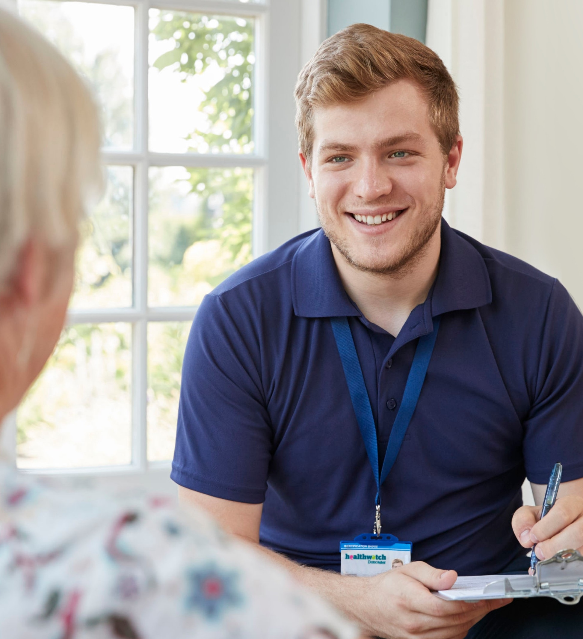

Together
we’re making health
and social care better
Annual Report 2022–23

Slide 2

Contents
Message from our Chair
About us
Our Year in Review
How we’ve made a difference this year
10 years of improving care
Healthwatch Hero
Listening to your experiences
Making a difference
Hearing from all our communities
Advice and Information
Volunteering
Finance and future priorities
Statutory Statements
The way we work
3
4
5
6
7
8
9
10- 12
13-14
15-16
17-18
19
20
21
"In the last ten years, the health and
social care landscape has changed dramatically, but the dedication of local Healthwatch hasn't. Your local Healthwatch has worked tirelessly to make sure the
views of local people are heard, and NHS and social care leaders use your feedback to make care better."
Louise Ansari, Healthwatch National Director

Slide 3
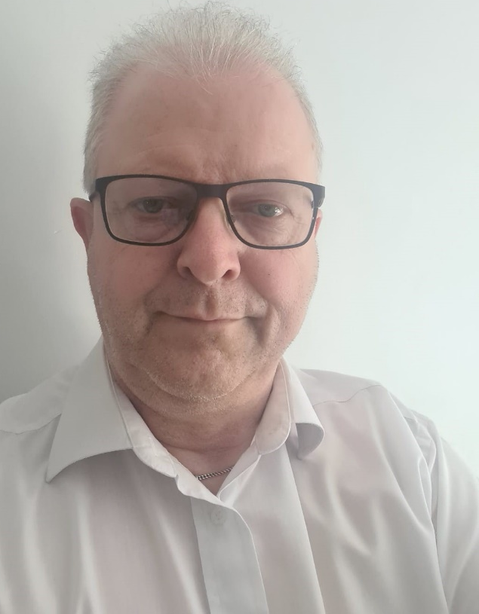
Message from our Chair
Welcome to the annual report of Healthwatch Doncaster for 2022-2023. This is the first annual report from myself as Chair of HW. I would like to take this opportunity to thank Steve Shore for all his hard work and the 10 years he dedicated to Healthwatch Doncaster and wish him every success in the future.
Healthcare in Britain has seen many changes, and the last year is no exception. The creation of the ICB (integrated care board) being a change to the way in which we all work.
Our aim has been and continues to be that the voices of Doncaster are heard at place level and now, at South Yorkshire level as well. This is our continued commitment every year.
I’d like to thank the board, staff, and volunteers for their continued support and particularly in welcoming me into post. And I would like to welcome our new members to the board, new staff and new volunteers.
This coming year is not without its challenges but I am confident that we have a competent team to match these challenges and I look forward to working alongside you all.
Andrew Bosmans
Healthwatch Doncaster Chair
Recently, I have unfortunately had to spend significant time experiencing the methodology of A and E and as an advocate of free health care I can see its value but also its frustrations, the waiting and the many pitfalls, both real and potential; which is why I believe in the notion of Healthwatch and its advocacy for healthcare users everywhere.

Slide 4



About Us
Healthwatch Doncaster is your local health and social care champion.
We make sure NHS leaders and decision makers hear your voice and use your feedback to improve care. We can also help you to find reliable and trustworthy information and advice.
Our vision
A world where we can all get the health and care we need.
Our mission
To make sure people’s experiences help make health
and care better.
Our values are:
Listening to people and making sure their voices
are heard.
Including everyone in the conversation – especially those who don’t always have their voice heard.
Analysing different people’s experiences to learn how
to improve care.
Acting on feedback and driving change.
Partnering with care providers, Government, and
the voluntary sector – serving as the public’s independent advocate.

Slide 5


Our Year in Review
Reaching out
3576 people
shared their experiences of health and social care
services with us, helping to raise awareness of issues and improve care.
359 people
came to us for clear advice and information about topics such as mental health and the cost of living crisis.
Making a difference to care
We published
6 reports
reports about the improvements people would like
to see to health and social care services.
Our most popular report was
Dive into our Dementia Insight Report
which highlighted the struggles people face within the health sector.
Health and care that works for you
We’re lucky to have
23
outstanding volunteers who gave up 637 hrs to make care better for our community.
We’re funded by our local authority. In 2022-23 we received
£175,734
which is the same as last year.
We currently employ
6 staff
who help us carry out our work.

Slide 6








How we’ve made
a difference this year
Spring
Listened to parents at local events and family hubs about their experiences, a voice often unheard.
We continued to connect people with vaccination opportunities across Doncaster.
Summer
By working with local people we were able to shape the co-production of local dementia services.
Your views and opinions supported what will happen at local level in pharmacies across Doncaster, in autumn 2023.
Autumn
Partnering with our ICS meant we could bring patient stories to life and share what works well and how services can improve.
Being part of Doncaster Bassetlaw Maternity Voice Partnership enables change where it is needed most.
Winter
Our Enhanced Access Survey shone a light on the education needed around the wonderful work happening in our local Primary Care Networks.
We’ve shaped local health care for the next 5 years by listening to what matters to people the most.

Slide 7






10 years of improving care
This year marks a special milestone for Healthwatch. Over the last ten years, people have shared their experiences, good and bad, to help improve health and social care. A big thank you to all our Healthwatch Heroes that have stepped up and inspired change. Here are a few of our highlights:
How have we made care better, together?
Vaccine confidence
Our research exploring vaccine confidence with people from different backgrounds provided vital lessons for public health campaigns.
Missed Appointments
By working with Doncaster Bassetlaw Hospital Trust we influenced the implementation of text messages and digital letters to avoid missed appointments..
Patient transport
NHS England announced improvements to non‑emergency patient transport services thanks to public feedback.
100 Day Improvement Challenge
Support services within Doncaster Bassetlaw Hospital Trust to significantly improve within a rapid time frame.
Waiting list support
After we and other organisations called for an urgent response to hospital waiting lists, and better interim communication and support, the NHS set out a recovery plan to address the backlog.

Slide 8
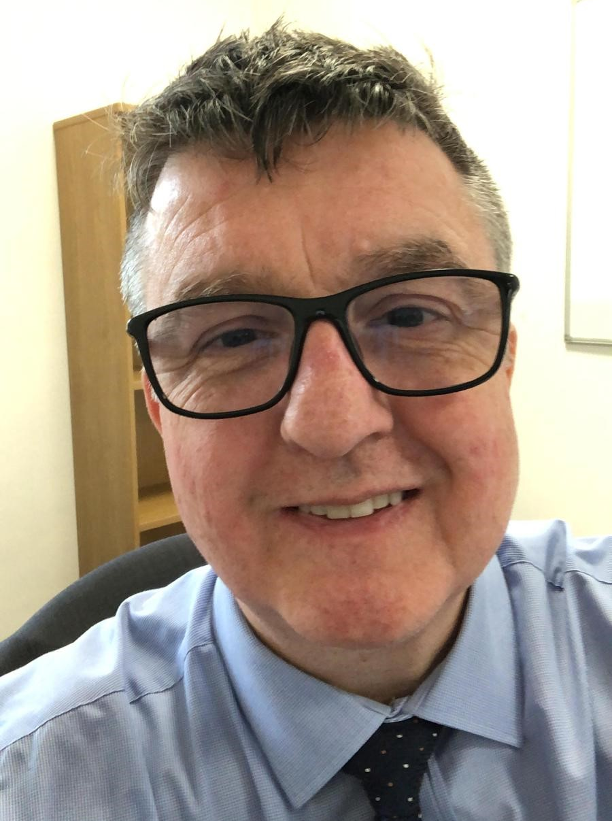

Healthwatch Hero
Celebrating a hero in our organisation.
Stephen Shore is undoubtedly our Healthwatch Hero here in Doncaster, his commitment to Healthwatch spans over ten years helping the organisation strive for better health and social care services locally.
Steve stepped down as Chair in February. He accepted a new position as Employment judge, for the Ministry of Justice which meant he was unable to continue as Chair, a real loss for Healthwatch, but we wish him every success.
His relationships with the local health and wellbeing board and members of parliament made the difference when we needed change to happen right here in the heart of Doncaster.
Steve acted as a mentor to many of the staff team, supportive yet he was not afraid to challenge their thinking to initiate change management.
We’d like to take this opportunity to thank Stephen for his time and commitment to Healthwatch Doncaster, without you we wouldn’t be where we are today. And hope that he pops in for a coffee from time to time.
Thank you Steve.

Slide 9
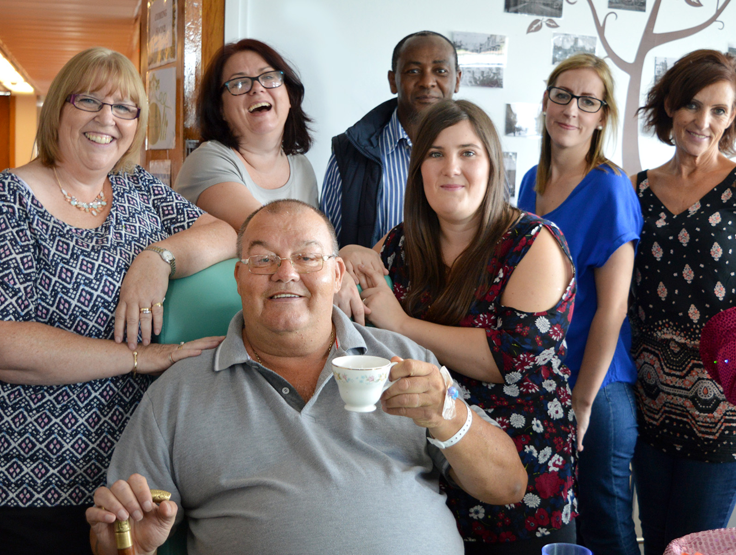
Listening to your experiences
Services can’t make improvements without hearing your views. That’s why over the last year we have made listening to feedback from all areas of the community a priority. This allows us to understand the full picture, and feed this back to services and help them improve.

Slide 10


Advocating for fairer
NHS Dentistry
NHS dentistry is in desperate need of reform and this year we have successfully moved NHS dentistry up the political agenda, making it easier
for people to find a dentist taking on NHS patients.
With living costs on the rise, our new findings show widening health inequalities as people in every part of the country struggle to pay for dental care.
We have seen a shortage of NHS appointments, which has affected people
on the lowest incomes the most, meaning they were less likely to have dental treatment than those on higher incomes.
We made renewed calls on NHS England and the Department of Health and Social care to put a reformed dental contract in place.
Changes to NHS dental contracts
Our findings achieved widespread media attention and as a result NHS England announced changes, including:
Increasing the payments for dentists when treating patients with complex needs, for example, people needing work done on three
or more teeth.
Requiring dental practices to regularly update the national directory
as to whether they are taking new NHS patients.
Moving resources from dental practices that are underperforming.
What difference will this make?
This announcement showed the power of people’s feedback – with decision makers listening to your voice and taking action.
With these changes in place it should be easier for people to find a new dentist taking on NHS patients, elevating the stress and worry so many suffer when they cannot afford to go private.
Our Local Commitment
We recognise that there is an ever growing need for local dentists to help people with their oral health needs. The demand is greater than ever, so our student placements spend time each week updating a weekly tracker which informs us of the dentists within Doncaster who are taking on NHS patients and whether this is adults, children or both. We’d like to take this time to thank them for their commitment to keeping local people informed every week of the year.

Slide 11

Phlebotomy – A drive through experience
Traditionally patients would visit their local GP practice or hospital for blood tests requested by their clinical professional. With the hit of covid-19 an innovative approach has been developed and delivered in Doncaster so people can access phlebotomy services in a safe and convenient way which suits them.
We wanted to know what was behind the great success of the drive through phlebotomy service and if there was a future for this service as we returned to a face to face interacting people focussed world.
How the service works:
You visit the drive through service at a time and on a day that is suitable to you – no appointment required.
You remain in your vehicle. The clinician comes to you and performs the test.
Your sample is sent to be tested in the same way as it would have been, had you have visited your GP practice or local hospital.
You are able to drive away having completed your blood test with little inconvenience to your day.
We conducted a survey in which we received 966 responses. The survey was accessible online and ran for a time period of four weeks. Questions included asking people why they chose the drive through service, what they thought the benefits were of attending this site rather than others, what works well and what could be improved. Insights included:
“I could go at a time that suited me around work”
“It is so much easier than trying to get an appointment at my GP or parking at the hospital, and not having to get out of your car is a godsend”
“My mother is in her 80’s does not walk very well so easier to take her here. Not having to get her in and out of car”
What difference has this service made to people’s lives?
This service has been revolutionary for not only people with mobility and access needs but also the working individual who’s schedule doesn’t fit booking time off work for a blood test. From our survey the drive-through phlebotomy service has been further funded £75,000 to continue delivering a much needed service to people in Doncaster.

Slide 12


Three ways we have made a difference in Doncaster
Throughout our work we gather information about health inequalities by speaking to people whose experiences aren’t often heard.
Creating empathy by bringing experiences to life
It’s important for services to see the bigger picture. Hearing personal experiences and the impact on people’s lives provides them with a better understanding of the problems.
In Doncaster we work with our Integrated Care Board to illustrate what works well and what needs improvement within services. We do this by telling people’s stories in their words. For example; we shared a story around access to GP’s for people from the traveller community and the discrimination they faced when trying to register. The outcomes from highlighting the issues has led to practices delivering culture competency training for staff, which led to access and registration no longer being a barrier to healthcare..
Getting services to involve the public
Services need to understand the benefits of involving local people to help improve care for everyone.
Our Doncaster wide Patient Participation Group Network creates a unique and beneficial relationship between local people and primary care professionals. By facilitating a network we are able to act as the conduit and escalate issues when required. Patients raised a significant issue with access to Audiology, we were able to raise their concerns with the hospital trust and they were able to share with us how they are currently addressing the issues to resolve them in a timely manner.
Improving care over time
Change takes time. We often work behind the scenes with services to consistently raise issues and bring about change.
A great example of this is how we address health inequalities through our Health Ambassadors programme. We have representatives from across Doncaster who represent some of our most under served communities. Represented communities include; women from an ethnic minority background, people seeking asylum and refugees, LGBTQIA+, young people with additional needs, people who are hard of hearing, to name a few. Representatives raise relevant issues, for example people where English isn’t their first language struggle to navigate automated phone systems e.g. NHS 111. We then raise this with the relevant services and challenge until an appropriate outcome is found.

Slide 13
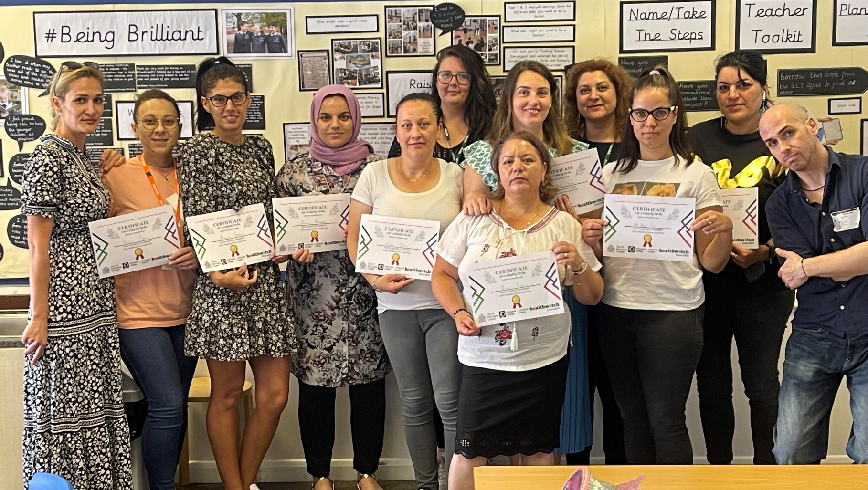
Hearing from all communities
Over the past year we have worked hard to make
sure we hear from everyone within our local area.
We consider it important to reach out to the
communities we hear from less frequently, to
gather their feedback and make sure their voices
are heard and services meet their needs.
This year we have reached different communities by:
  Co-producing health fayres in schools, in areas of high deprivation where attendees can enter to win a free digital tablet.
  Carried out focus groups with Chinese, Roma, Refugee, People Seeking Asylum, Polish, Caribbean, Muslim Women, Young people, deaf/hard of hearing communities and people in recovery, to ensure their voices are included in the upcoming ICP strategy.

Slide 14
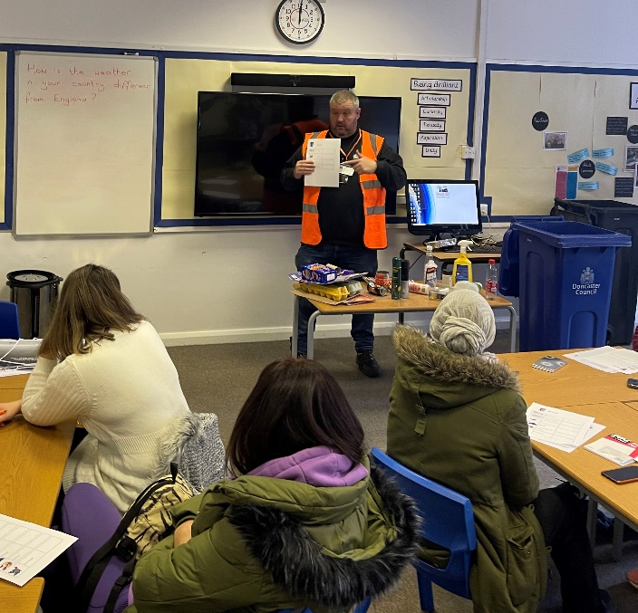

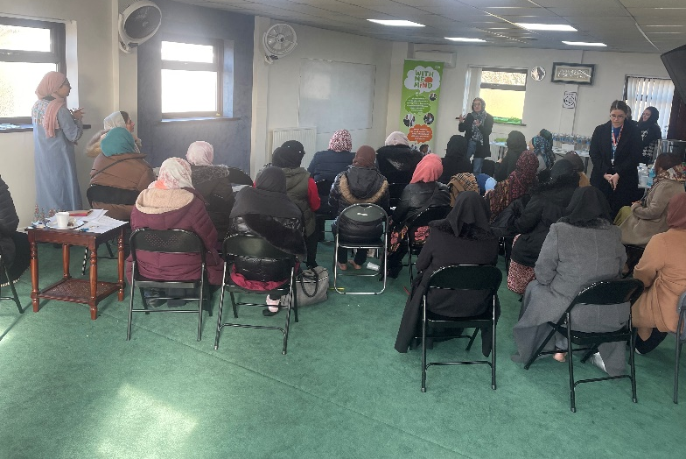
Tailoring to need
While working with underserved communities in Doncaster a lot of feedback received was about the desire to access ESOL classes but a challenge around this was timing and location/ transport.
From this, we worked with Doncaster Council and Doncaster College and set up ESOL classes in an area with high levels of non-English speakers and high levels of deprivation. We linked in with a local primary school that hosted the sessions
There was a 100% pass rate for the ESOL classes and those that attended received a kindle fire to support in bridging the gaps to digital exclusion and health inequalities.
Linking in with the English classes we arranged for various services to deliver talks, these included, Healthwatch Doncaster Waste and Recycling, Employment, Reproductive Health and Talking Therapies. The resources provided were in either easy read or translated to attendees languages.
Another barrier highlighted was around accessing English classes and needing childcare. We worked with Doncaster Councils Adult and Family Learning team who set up 6 weekly sessions of English provision and each session was child friendly, again held at a local school.
“‘ This course is helping me to better communicate in my daily life. I can make a doctor appointment easier, I can speak with my neighbour’’ Local resident
Breaking down barriers to Mental Health
Mental health is considered a taboo subject in some underserved communities and accessing help is not always an option. Healthwatch Doncaster worked with Doncaster Council, Talking Therapies, Mind and Children’s and Adolescents Mental Health Service to bring talks to a group of Muslim women in one of Doncaster’s local Mosques.
The talks included myth busting and tailored for those attending. There was an opportunity for those attending the mantal health talks to have one on one discussions with services and receive signposting information.
During the question and answer sections we saw more of the woman open up about mental health be it their own or a family member and be open to the services and getting help.

Slide 15
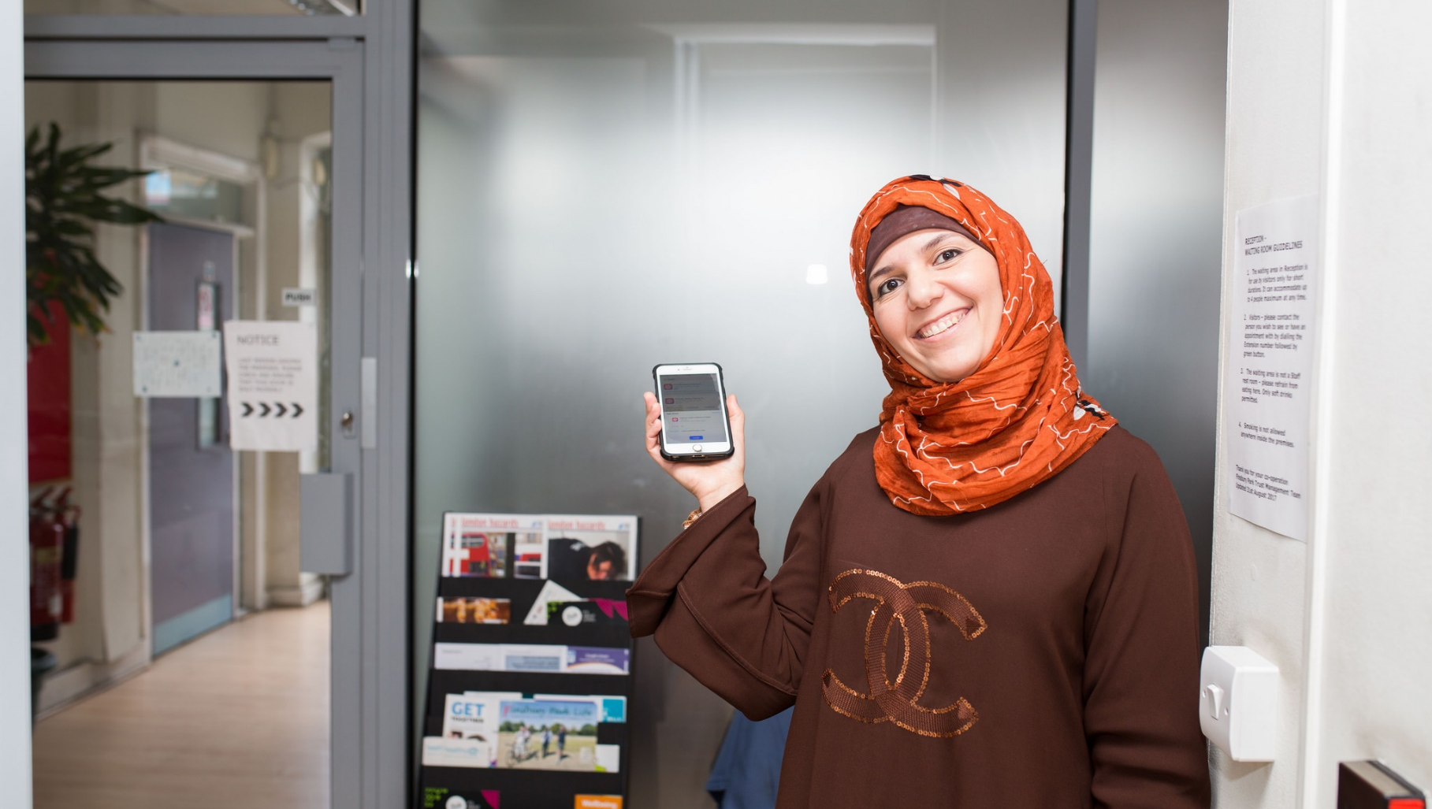
Advice and information
Healthwatch Doncaster is always here to listen to you, to help sign post you to the right place and support you in the best possible way. You can pick up the phone, contact us via the web or perhaps for the more digitally connected amongst us share your feedback with us on social media.
This year we’ve helped people by:
  Sign posting people to the right service for the right problem
  Abolishing the pre-conceived barriers of requiring an address or ID to register at
  a GP Practice
  Week on week we connect local people with NHS dentistry services
  Supporting people to look after their own health during the cost
  of living crisis

Slide 16

Access to Primary Care
Healthwatch Doncaster are often approached by local community members who are told by local GP practices they are unable to register due to the fact they have no proof of address or ID.
Our engagement team challenged people’s rights to equal access to healthcare and we helped community members by sharing the ‘Yellow Card’ and ‘Right to Register’ information with practices. This leaves local practice’s with the right to refusal only if their registration books are closed.
“It just made no sense as to why they turned me away. I’m so so happy I now have a doctor to help me.”
Angie – Doncaster Resident
Healthwatch Doncaster’s support has meant people who need access to regular prescriptions and appointments with primary care clinicians can be facilitated. For us this has been an incredible achievement enabling access for people shouldn’t have faced any barriers in the first instance.
Sign posting people to the right service for the right problem
Many people can have their health needs met without emergency clinical intervention. We commit our time to inform people of alternative services available.
Our local emergency departments are always reporting about the immense pressures they face from people attending the service when in actual fact they could have used an alternative service and still received the appropriate medical care.
We wanted to help inform local people of where else they could go to receive care over the winter months so we developed a winter campaign using a Healthwatch mascot illustrating various services such as; our local minor injuries department at Mexborough Montague Hospital, a local pharmacy, advocating self care and the same day health centre
The response on our social media channels was uplifting, we hope the learning from this remains with people in our local area.

Slide 17
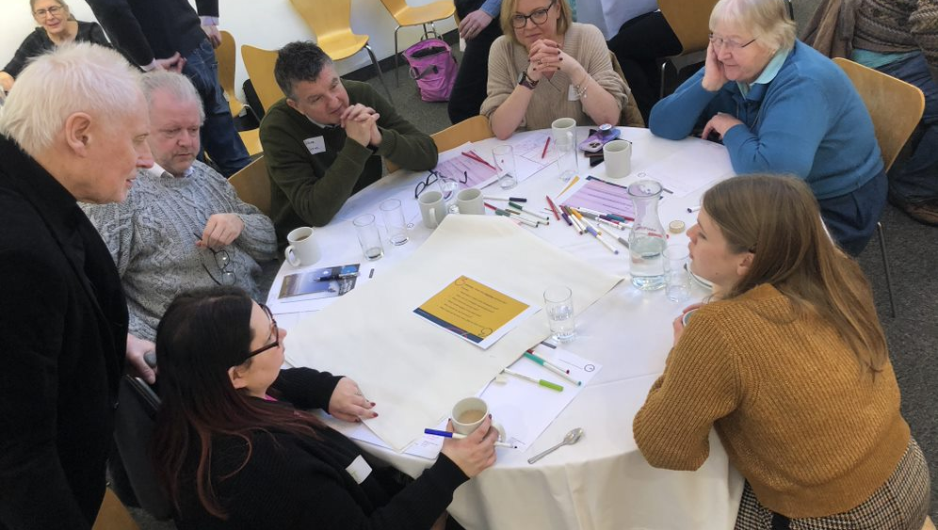
Volunteering
We’re supported by a team of amazing volunteers who are at the heart of what we do. Thanks to their efforts in the community, we’re able to understand what is working and what needs improving.
This year our volunteers:
  Visited shopping centres and supermarkets to get feedback on what is important to people about their health and wellbeing
  Collected survey responses from communities around extended access and people’s awareness of this offer
  Attended and contributed to the Healthwatch Regional away day
  Attended health fayres held in schools with high levels of deprivation and underserved communities to extend the outreach of Healthwatch Doncaster is.
  Collected feedback on the new health hubs proposed for Doncaster.

Slide 18
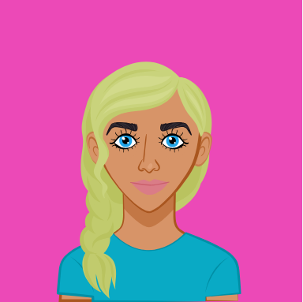

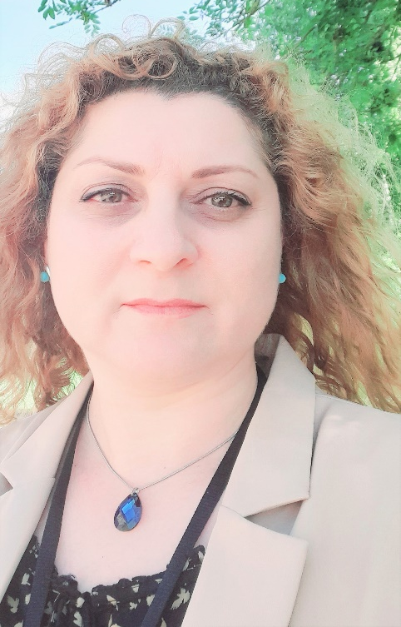



Alicia
Volunteering for Healthwatch Doncaster has helped me build up my confidence and makes me feel like my voice and opinion is heard and will hopefully help more people be open and raise their concerns.
I created a list that holds all the dentists in Doncaster and update this each week by contacting each one, this is then shared with a distribution list and on social media.
Alina
I recently joined Healthwatch’s Board and I am very
exciting. I feel inspired working with such a great team.
Their work is making a difference in people’s lives here
in Doncaster. I used to work with Sian Owen in our
previous roles. She is knowledgeable and dedicated
professional whose work was instrumental in tackling
the barriers in people’s access to health and wellbeing.
Her work remains instrumental in developing a network
of volunteers working to address health inequalities
that prevents the access of health minority populations
to health and care.
Do you feel inspired?
We are always on the lookout for new volunteers, so please get in touch today.
https://www.healthwatchdoncaster.org.uk/01302 965450
Sian.owen@healthwatchdoncaster.org.uk

Slide 19
Finance and future priorities
To help us carry out our work we receive funding from our local authority under the Health and Social Care Act 2012.
Our income and expenditure
Income |  |  | Expenditure
Annual grant from Government | £175,734 |  | Expenditure on pay | £137,550.03
Additional income | £42,884 |  | Non-pay expenditure | £22, 454.87
 |  |  | Office and management fee | £36,004.79
Total income | £218,618 |  | Total expenditure | £195,716.41
Additional income is broken down by:
£14,500 received from the City of Doncaster Council for a project
£13,500 received from the City of Doncaster Council for hosting a Community Connector
£6,000 received from the ICB for engagement support
£5,000 received from Primary Care Doncaster for a project
£2804.80 received from ICB to support admin costs
£979.20 received for media costs
Next steps
In the ten years since Healthwatch was launched, we’ve demonstrated the power of public feedback in helping the health and care system understand what is working, spot issues and think about how things can be better in the future.
Services are currently facing unprecedented challenges and tackling the backlog needs to be a key priority for the NHS to ensure everyone gets the care they need. Over the next year we will continue our role in collecting feedback from everyone in our local community and giving them a voice to help shape Improvements to services.
We will also continue our work to tackling inequalities that exist and work to reduce the barriers you face when accessing care, regardless whether that is because of where you live, income or race.
Top three priorities for 2023-24
To spread our reach into underserved communities and establishing a larger and more diverse network of volunteers .
Improving access to GP’s and educating the public on how they access their GP and the alternative services available
Hearing the voices of young people in Doncaster and making their voices louder.

Slide 20
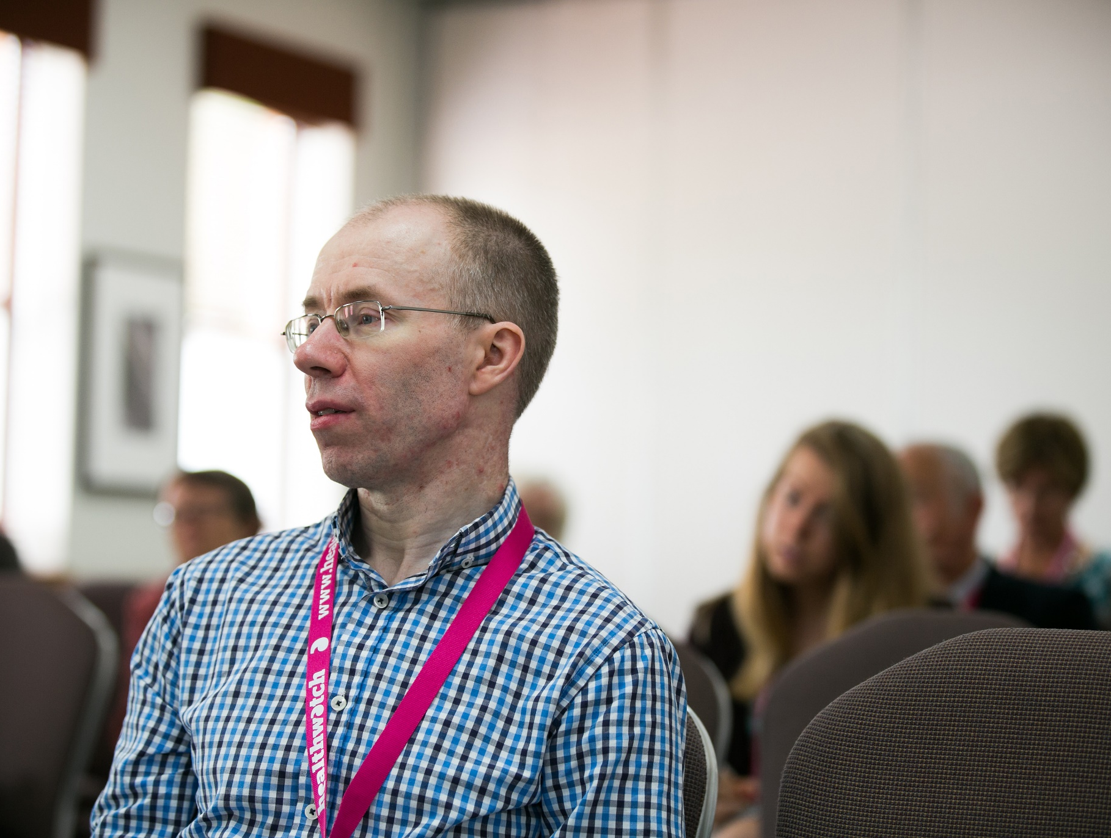
Statutory statements
Doncaster Healthwatch CIC, 8d Cavendish Court, South Parade, Doncaster, DN1 2DJ
Healthwatch Doncaster uses the Healthwatch Trademark when undertaking our statutory
activities as covered by the licence agreement.

Slide 21
The way we work
Involvement of volunteers and lay people in our governance and decision-making
Our Healthwatch Board consists of 7 members who work on a voluntary basis to provide direction, oversight and scrutiny to our activities. Our Board ensures that decisions about priority areas of work reflect the concerns and interests of our diverse local community. Throughout 2022/23 the Board met 12 times.
We ensure wider public involvement in deciding our work priorities.
Methods and systems used across
the year to obtain people’s experiences
We use a wide range of approaches to ensure that as many people as possible have the opportunity to provide us with insight about their experience of using services. During 2022/23 we have been available by phone, email, provided a webform on our website and through social media, as well as attending meetings of community groups and forums.
We ensure that this annual report is made available to as many members of the public and partner organisations as possible. We will publish it on our website cascade it through our networks and share it on our social media channels so our stakeholders can read about the change making work achieved in Doncaster.
Healthwatch representatives
Healthwatch Doncaster is represented on the Doncaster Health and Wellbeing Board by Stephen Shore, Chair of the Healthwatch Doncaster Board. During 2022/23 our representative has effectively carried out this role by and has actively been part of the Fairness and Wellbeing commission
Healthwatch Doncaster is represented on South Yorkshire Integrated Care Partnership by Fran Joel, Chief Operating Officer
Taking people’s experiences to decision makers
We ensure that people who can make decisions about services hear about the insight and experiences that have been shared with us.
In our local authority area for example we take information to Doncaster Place Committee, Primary Care Steering Group, Patient Experience Involvement Committee, Doncaster Fairness and Wellness Commission, Minorities Partnership, & Making It Real Board.

Slide 22




Healthwatch Doncaster
8D Cavendish Court, South Parade, Doncaster
DN1 2DJ
www.healthwatch.co.uk
t: 01302 965450
e: info@healthwatchdoncaster.org.uk
@HWDoncaster
Facebook.com/HealthwatchDoncaster
@HealthwatchDoncaster
HealthwatchDoncater

